Slide 1

Unilever Performance in Alignment with Egypt
Vision 2030
Presented by :
1- Asmaa Magdy
2- Ahmed Hossam El-din
3- Sondos Hassan

Slide 2
Content
Project Overview
01
04
Business Analysis
FMCG Market Analysis
02
05
Sustainability
Unilever Structure
03
06
Egypt 2030 Vision

Slide 3
Project Overview
01

Slide 4
Problem
Solution
Problem
Egypt Vision 2030 sets a comprehensive framework for sustainable development. The FMCG market, which accounts for approximately 30% of total retail activity in Egypt, is a major contributor to economic and social progress. However, a unified dashboard that links FMCG market performance to Vision 2030 objectives is still missing.
create a unified visualization tool that uses Unilever as a representative case to evaluate how an FMCG company’s financial, social, and environmental performance aligns with the pillars of Egypt Vision 2030. This approach demonstrates a scalable model that other market players can adopt.

Slide 5
FMCG Market Analysis
02

Slide 6

Market Analysis
Top 10 FMCGs Company per Revenue
Why Unilever is our Case ?
- Volume growth - Emerging markets
- Renewable Energy - Plastic Reduction

Slide 7
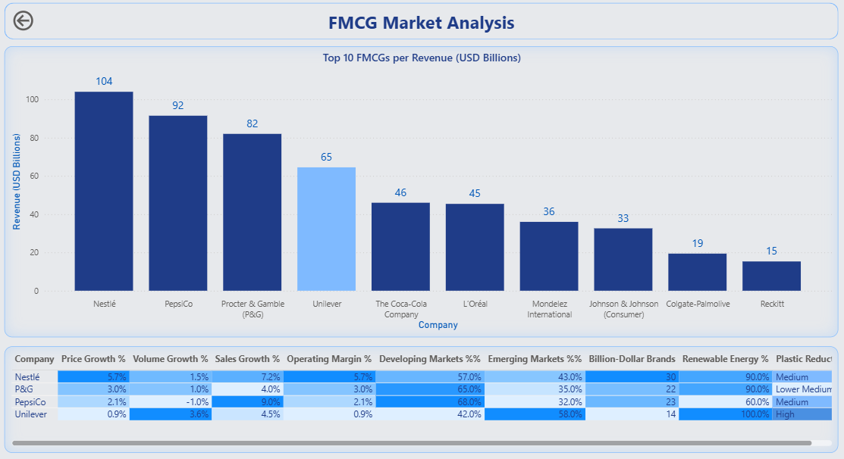

Slide 8
Unilever Structure
03

Slide 9

Unilever Structure
- Age Distribution
- Gender Distribution
- Region Distribution

Slide 10
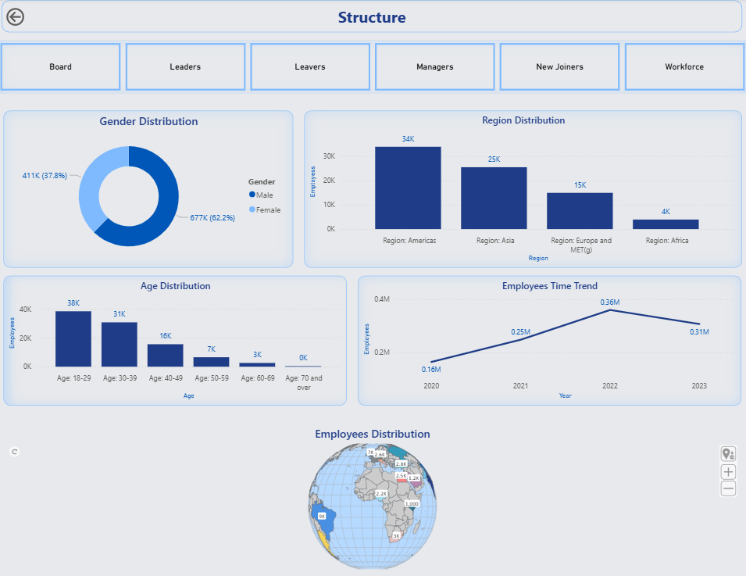

Slide 11
Business Analysis
04

Slide 12


Unilever Products
Analysis
Beauty
Segments
Personal Care
Home Care
Food & Refreshment

Slide 13
Unilever Products Segments
20%
26%
Home Care
Food & Refreshment
Analysis
Home Care
Beauty
Segments
Personal Care
Food & Refreshment
23%
30%
Personal care
Beauty

Slide 14
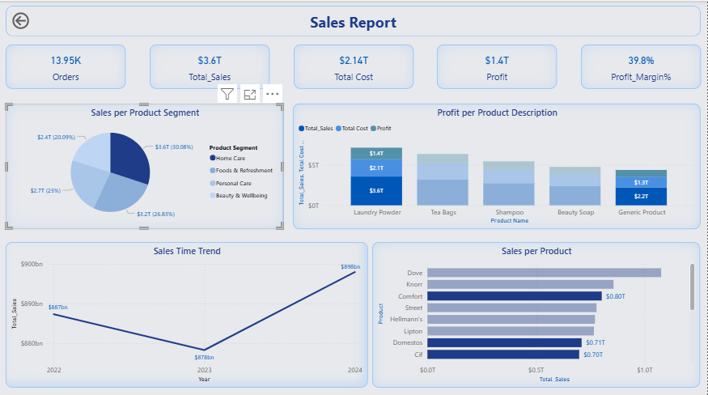

Food & Refreshment
Analysis
Beauty
about
Personal Care
Home Care

Slide 15
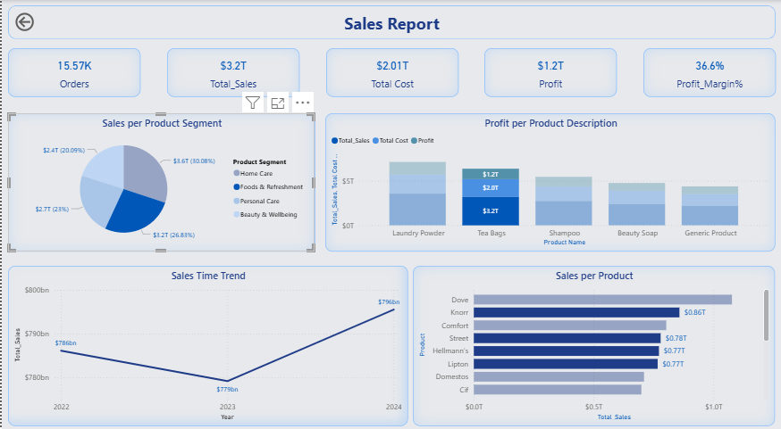
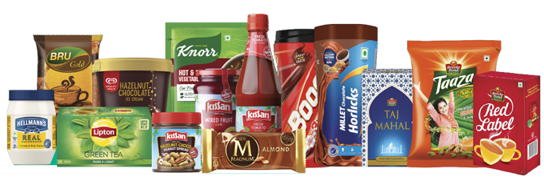
Analysis
Home Care
Beauty
Foods
Segment
  Personal Care

Slide 16
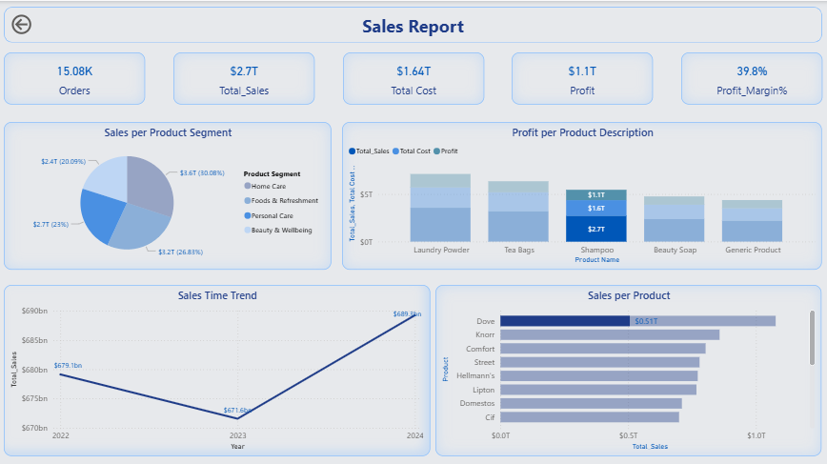
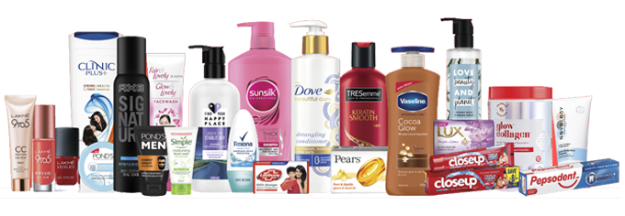
Analysis
Home Care
Beauty
Foods
Segment
Personal Care

Slide 17
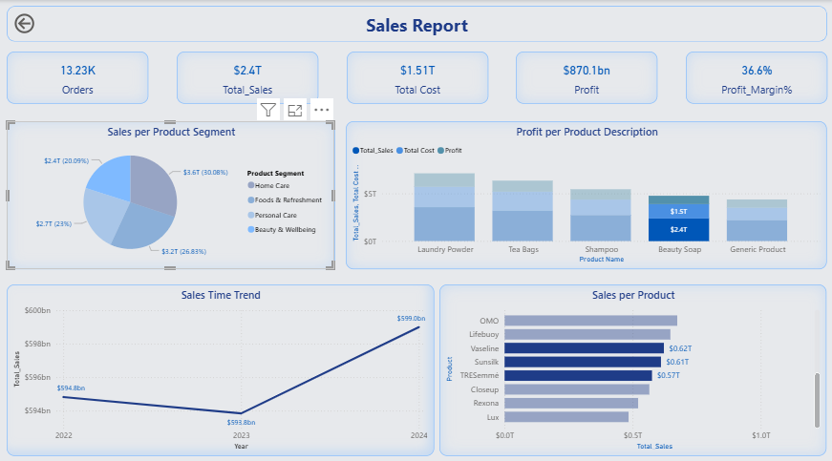
Analysis
Beauty
Home care
Food
Segment
Personal care

Slide 18
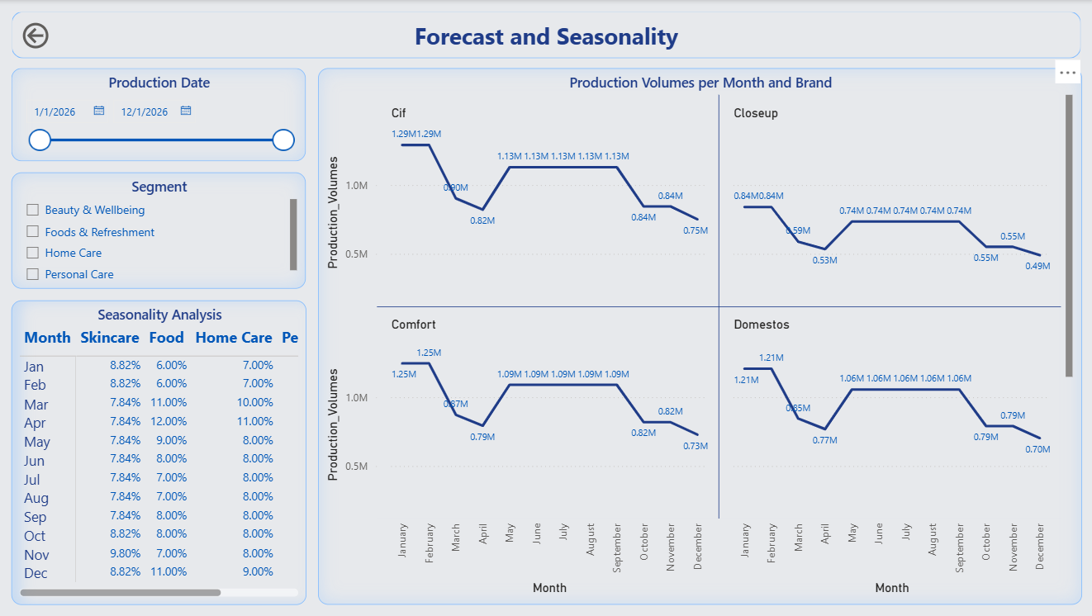
Analysis
history
teams
timeline
about

Slide 19
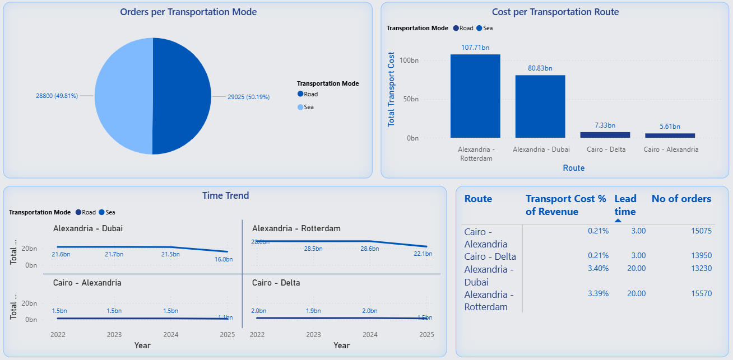
Transportaions

Slide 20
Sustainability
05

Slide 21
Sustainability
Water
Waste
Energy
Gas Emissions
Social
Economic
54% reduction in water use
34% reduction in Waste
24% reduction in energy use
74% reduction in emissions
Empowering communities and people
Strengthening supply chain livelihoods

Slide 22
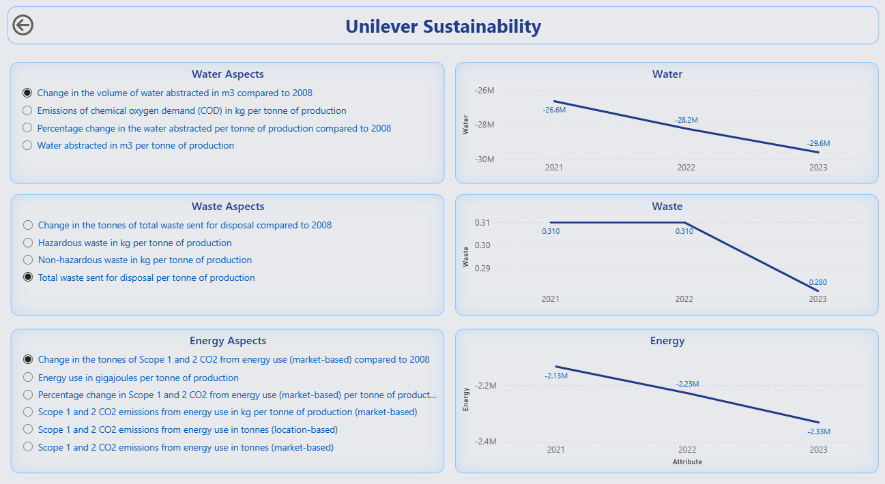

Slide 23
Egypt 2030 Vision
06

Slide 24
Egypt 2030 Pillars Forecasted Impact on Unilever Revenue
13%
5%
4%
4%
Economic
Enviromental
Social
Market & Consumer Opportunities

Slide 25
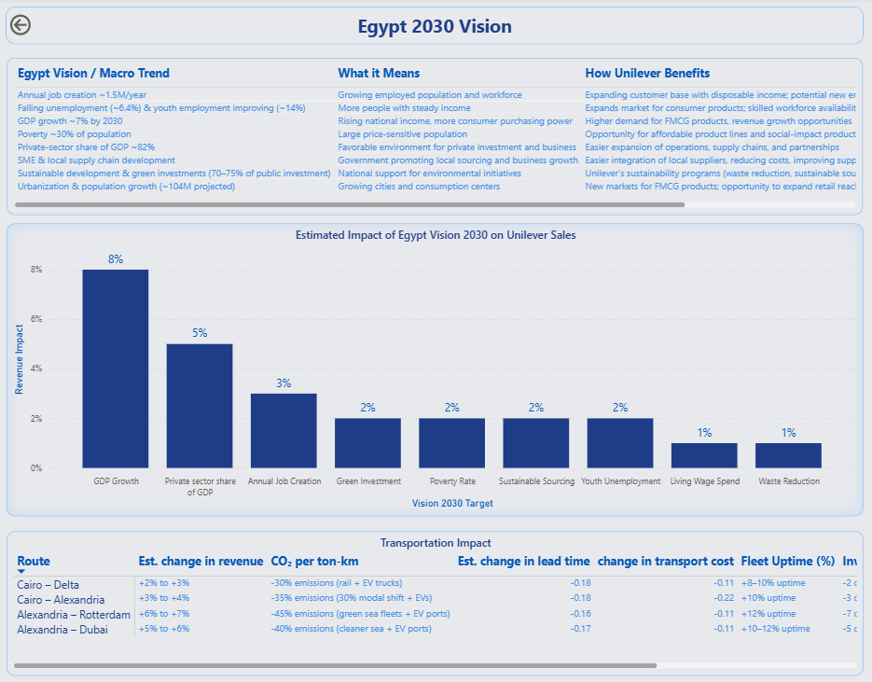

Slide 26
Sustainability Source : https://opennetzero.org/unilever
Revenue, Sales & Financial KPIs (Actual Company Data) • Source: Unilever Egypt (via parent Unilever Plc) • Links: - Unilever Annual Report 2023 - Unilever PLC Financials • Extracted: Revenue growth rates (2022–2023), FMCG segment shares. • Applied: Scaled down global revenues to Egypt operations size (~2–3% of Unilever MENA revenue).
Production & FMCG Market Volumes • Source: CAPMAS (Egypt Statistics) + Euromonitor FMCG Egypt reports. • Links: - CAPMAS Egypt - Euromonitor Egypt FMCG • Extracted: Packaged foods & home care market growth ~6–8% CAGR. • Applied: Monthly production volumes scaled from FMCG growth rates.
Transportation Modes & Costs • Source: World Bank Logistics Index, UNCTAD, Egypt news (fuel, trucking). • Links: - World Bank LPI - UNCTAD Shipping Data • Extracted: Road highest cost/kg, sea freight spike (2022–2023), air fastest but ~10× sea. • Applied: Estimated Transport cost (EGP) & Lead time (days) by mode/route.
Lead Times (Logistics Performance) • Source: Trading Economics + World Bank LPI 2023. • Links: - Trading Economics Egypt Logistics - World Bank LPI 2023 • Extracted: Road ~5–8 days, sea ~20–35 days, air 3–6 days. • Applied: Assigned Lead time (days) by transport mode.
Currency Source • Source: Central Bank of Egypt FX rates. • Links: - CBE Historical FX • Extracted: EGP baseline, inflation adjustments. • Applied: Currency_source column filled with 'CBE / Local EGP'. ■■ How I Combined the Data
Thanks

